Slide 1
REACT: SYNERGIZING REASONING AND ACTING IN LANGUAGE MODELS
ArXiv – Project – STAN49

Slide 2
REACT – (Reasoning + Acting)
On a high level, the ReAct framework enables LLM’s to utilize tools or functions while also extends the concept of chain-of-thought to chain-of-though-action-observing.
OpenAI’s plugin feature builds on the ReAct framework.

Slide 3
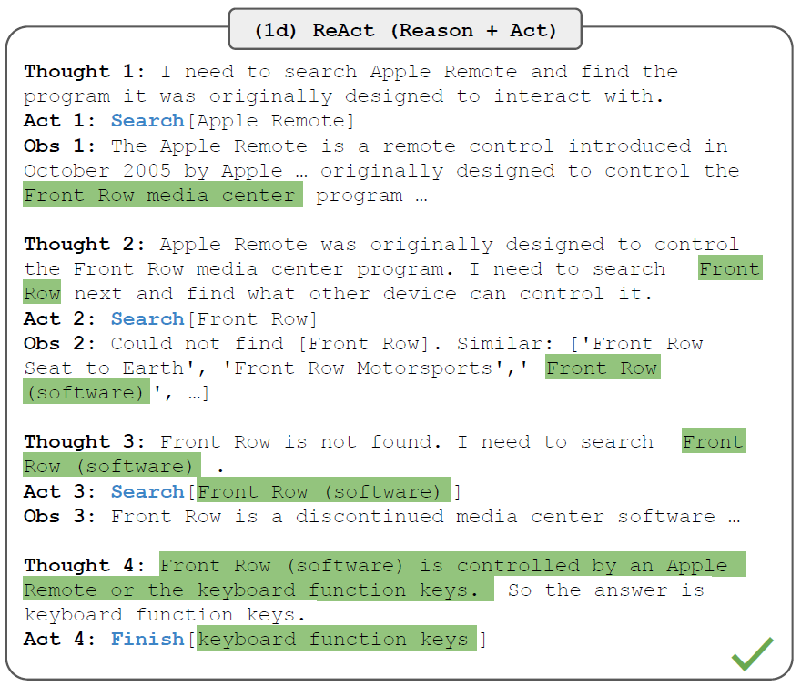
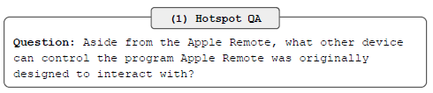
REACT – (Reasoning + Acting)
As the name suggests, the ReAct framework enables the LLM for reasoning and action taking.
Best demonstrated via example.
The LLM has then 2 tools at its disposal:
A Wikipedia search tool, Search[entity]
A Wikipedia lookup tool (ctrl+F sim), lookup[string]
These tools and Finish[] makes up the actions the Agents can take.
https://arxiv.org/pdf/2210.03629.pdf

Slide 4
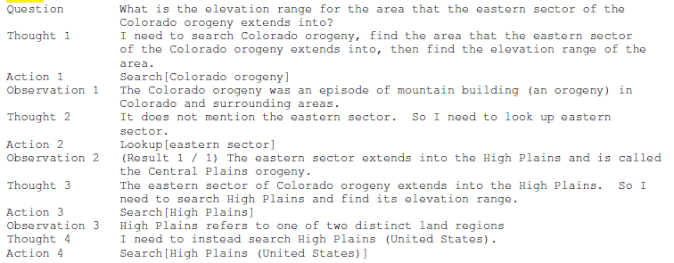
REACT – How?
How does the next-word prediction LLM model know when to think and to take action?
Prompting…
In the paper, the ”agent” is fed with a few-shot prompting. i.e it is fed with a few examples of the thought-trajectory:

Slide 5
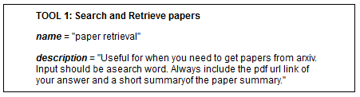
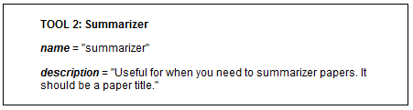
Implementation – LangChain – ArXiv BOT - Tools
Building LLM-agents in the python package LangChain is fairly simple
The ArXiv Chatbot has access to two tools.
The name and description are inserted in the prompt. It is based on the description that the LLM reason about whether or not to use that tool.

Slide 6
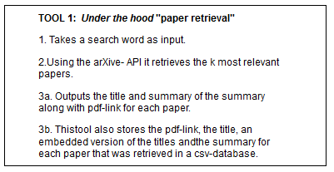
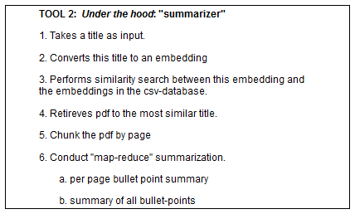
ArXiv BOT – Tools – Under the Hood

Slide 7
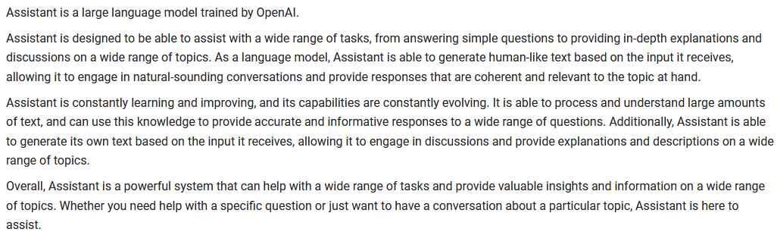
ArXiv BOT – Prompt
SystemMessage Prompt:

Slide 8
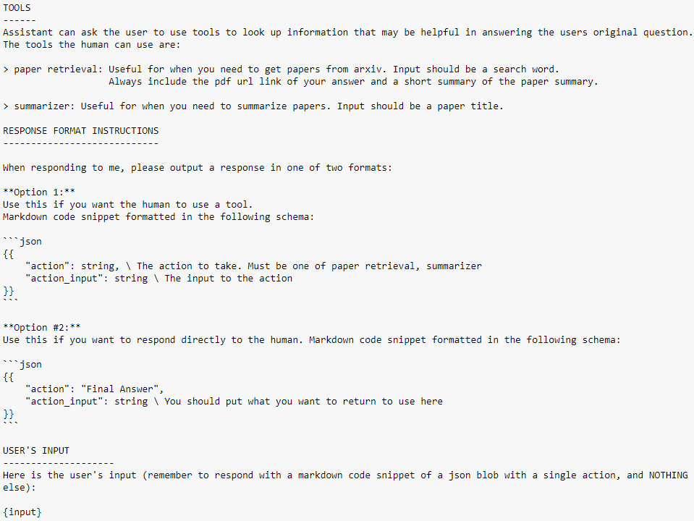
ArXiv BOT – Prompt
HumanMessage Prompt:

Slide 9
ArXiv BOT – Code
Check Code!

